Slide 1
Combined Smart parking lot system
1.Car recognition 2.Automatical parking assignment

Slide 2
Objective and significance
Part1:Car recognition
Whether the car plate number is registered or not
Whether the car plate number matches its appearance (color&model) or not
Significance: Detect the legitimacy of cars who is entering the parking lot and improve the security of parking lot
Part2:Automatical parking assignment Cars who has entered the parking lot will be assigned to an available parking slot
Significance: Save the time spend on finding vacant parking space

Slide 3
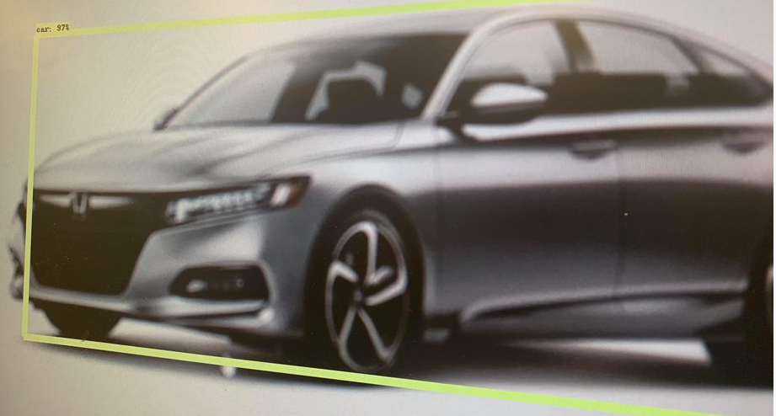
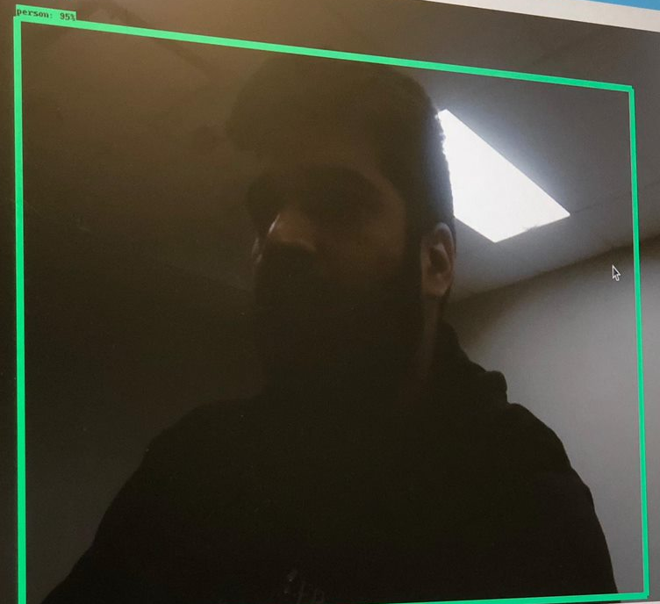
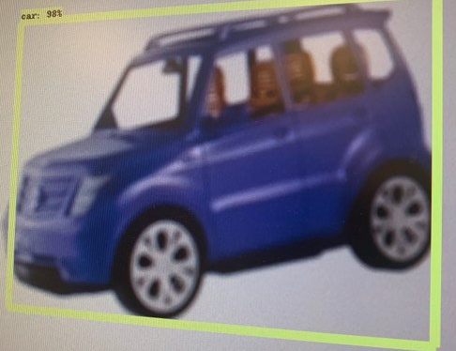
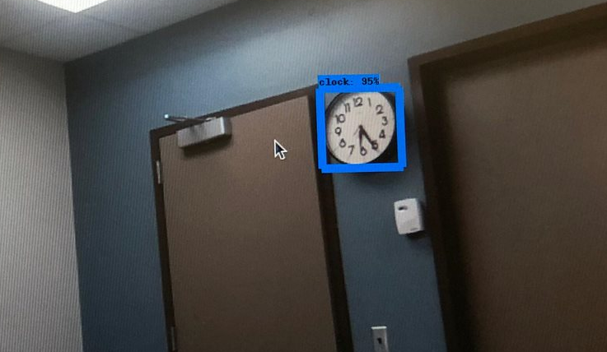
Previous work: Tensorflow Pi-camera Detection
Object detection with RPi
(person,clock,real car)
>95% Accuracy

Slide 4

An Open Web Server Support C++,java,python…. Analyzes Images Of Vehicles And Responds With License Plate, Model, Color And Much More Provide Database Service
Cloud server:Open ALPR

Slide 5
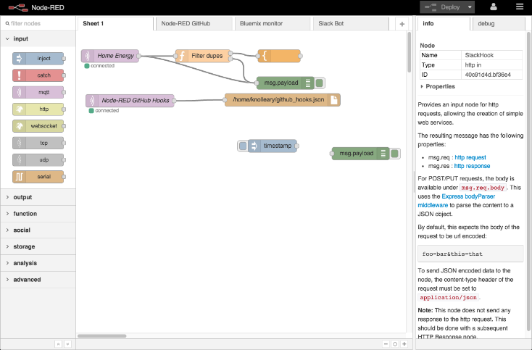
Single Object Detection With Tensorflow
Red-node:an System-flow Application

Slide 6
Part 1:Car Recognition
A car is coming
PIR sensor detects motion
Red-Node and Tensorflow
single object detection
Detect car’s appearance:
Car Color&Type
Pi-camera takes a picture
Red-Node
Read car plate number and compare it to database(Open ALPR)
Does the car model match its license number?
Further verification
No, it is illegal car
and call the police
Non-Registered
Yes, open the gate and let it in
Registered

Slide 7
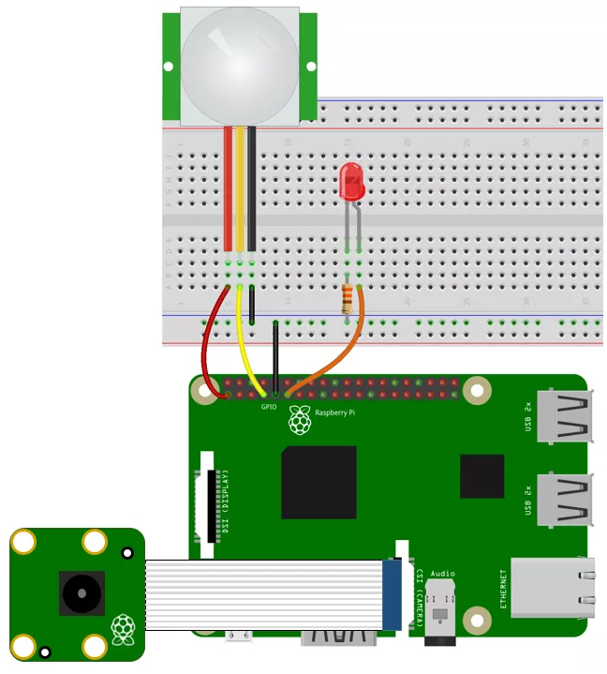
Hookup schematic:
Raspberry Pi
Pi-camera
PIR sensor
LED
A 1K resistor
Jumper wires
Pi-camera and PIR sensor are amounted at the entrance and are ready to detect
Use an LED to replace the gate of parking lot
LED is on ------------ Gate is opening
Detection Camera
Motion Sensor
Gate to entrance

Slide 8
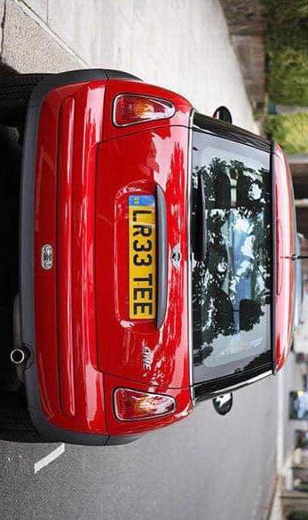
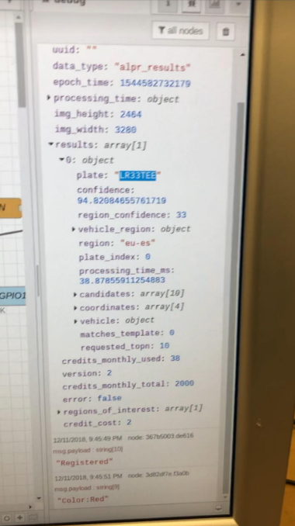
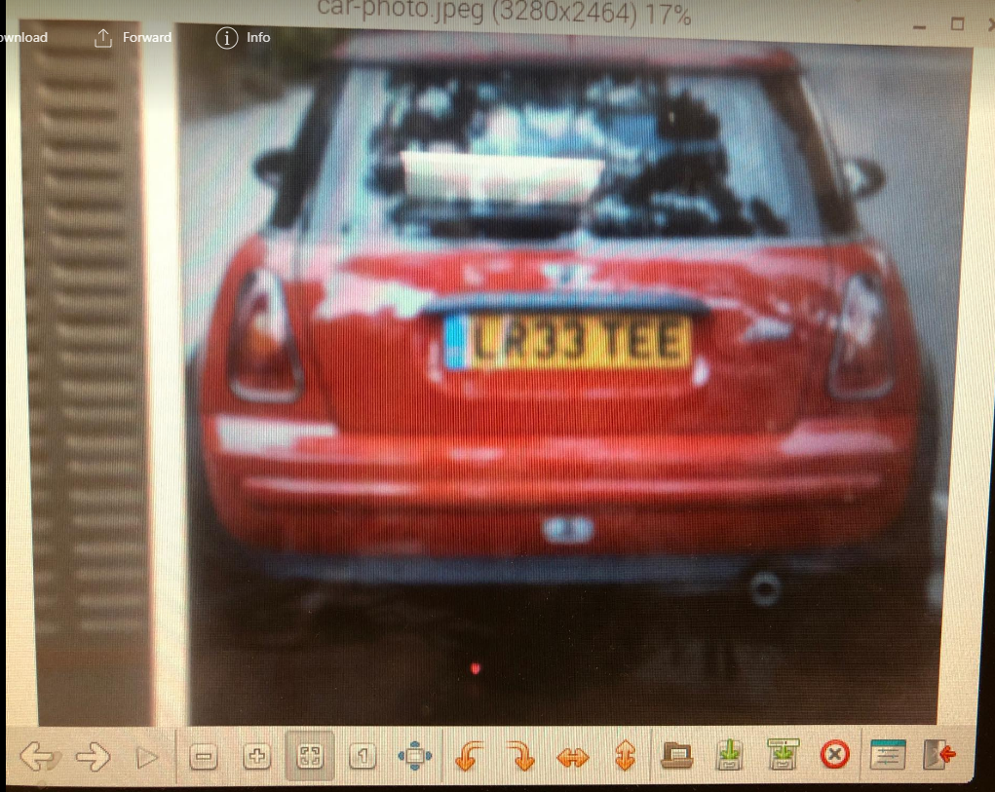
Screenshot And Part 1 Video Demonstration

Slide 9
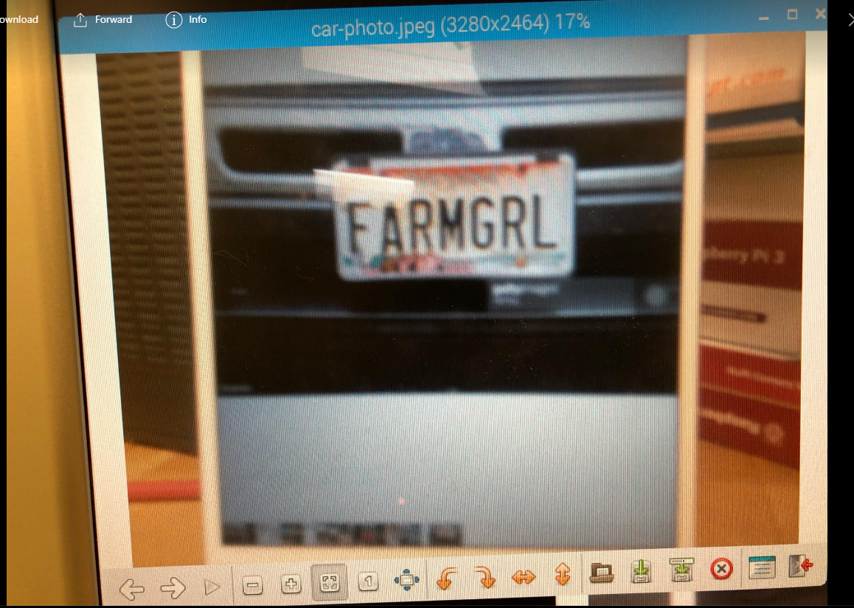
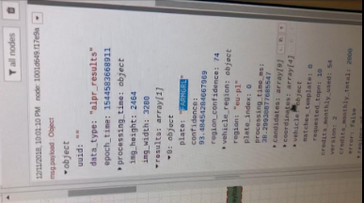
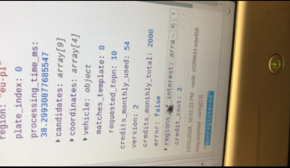
Screenshot And Part 1 Video Demonstration

Slide 10
Part2:Automatical parking assignment
IR sensors detect availability of parking slots
Info on each parking slot condition
Directly seen by administrator
A car enters the parking lot and the driver looks at the LCD screen
On LCD screen: Assign available parking slot to the car
Driver parks his car in the designated place

Slide 11
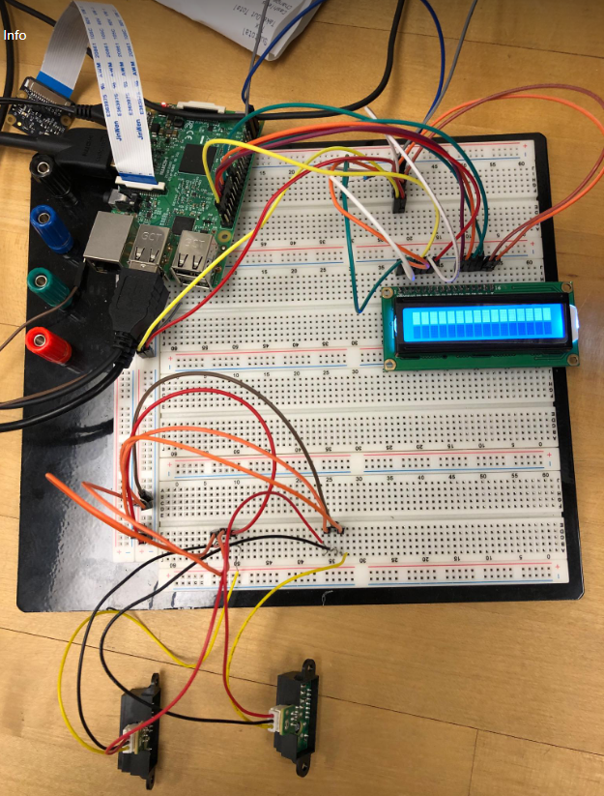
Hookup diagram
Rasperrby Pi
IR sensors
LCD display
Jumper wires
LCD is located in the gate so that everyone can see it once he/she enters
Each parking slot comes with an IR senor
Info screen
Multiple IR sensors working for respective parking skits

Slide 12
Part 2 Video demonstration

Slide 13
Project evaluation:
Part1:
Upside: High Detection Accuracy
Consistent system flow
Downside: Take >4s for detection
Only able to detect the color of the car(in the appearance)
Part2:

Slide 14
Thank you! Any questions ?

